Slide 1



E-learning Platform

Slide 2







Aditi Pandey Ahmed Fadil Akash Sil Anujna G. K. Ayushi Sah
Gagan S.
(Product owner)
Lakshitha Ravichandra
(Scrum master)
Bhawesh Agarwal Janesh Walia Konjeti Nidhi

Slide 3



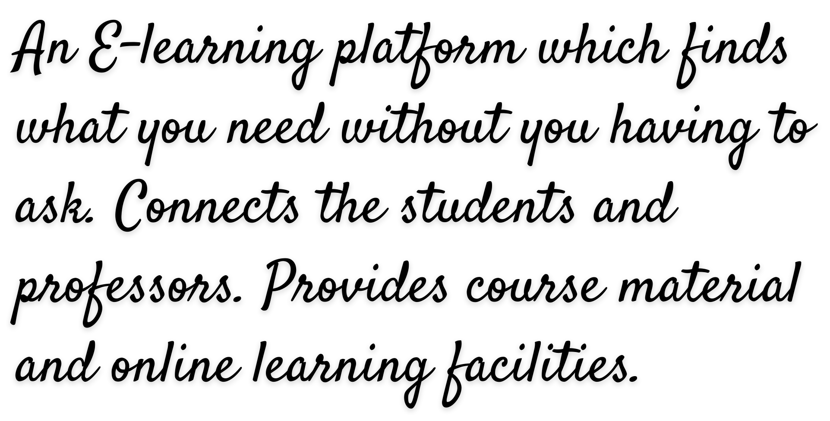

Slide 4






Conduct online interactive classes Share study material
Availability of videos of previous classes
Auto suggestions for reference material using syllabus pdf provided by the instructor
Manual chatbot for doubt clarification

Slide 5



Reference material provided based on the recorded class videos instead of syllabus pdf
Available for all colleges/ courses Support for multiple languages Auto doubt clarification on chatbot

Slide 6




GIT
Jenkins Docker
AI Model for Recommendation

Slide 7





Slide 8


